Slide 2
Graph

Slide 4
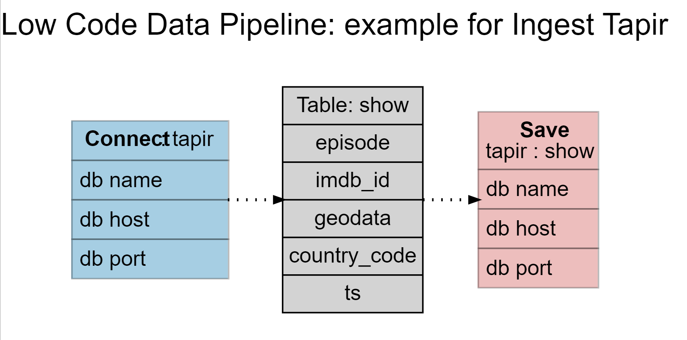
Ingest Tapir

Slide 5
